Slide 1

Quote Maker
A safe place for all the quotes

Slide 2


TEAMMATES
Tejaswi Avula​
​
Priyanka Maruthi

Slide 3
What is this app ?
This is a progressive web application that helps registered users to log in and check their daily quotes which would be an inspiration to start their day.
Login page with authentication
When we click on FOOTER REPOS IT WILL REDIRECT YOU TO THE PROJECT OF THE SPECIFIC BOARD

Slide 4




Stack Used

Slide 5
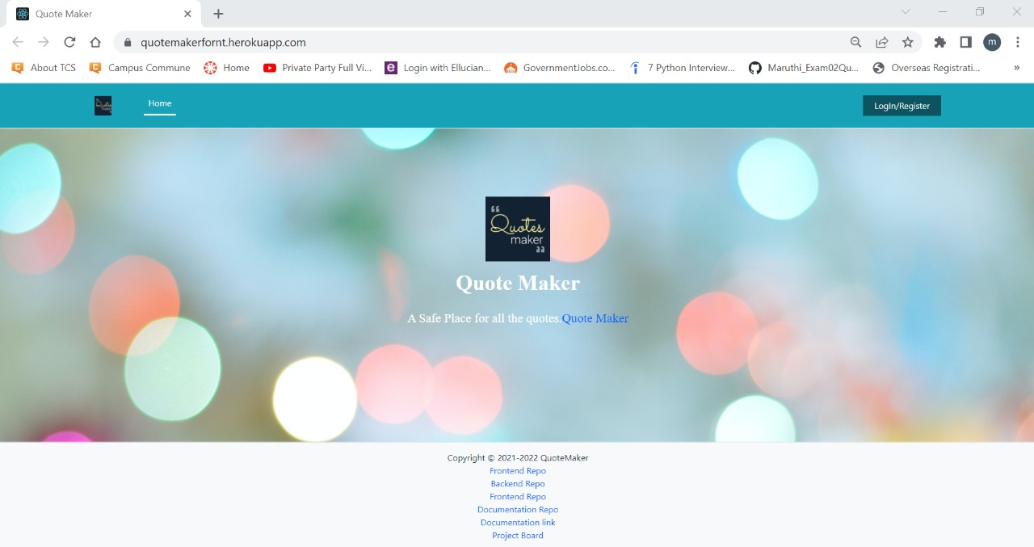
Home Page
https://quotemakerfornt.herokuapp.com/

Slide 6
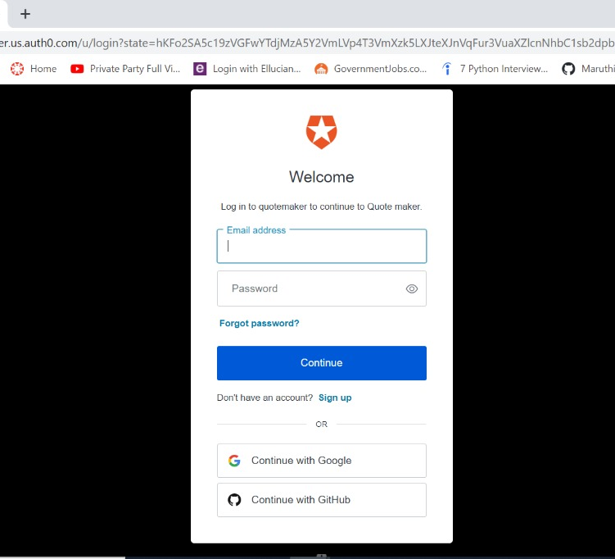
Login Page
https://quotemaker.us.auth0.com/u/login?state=hKFo2SA5c19zVGFwYTdjMzA5Y2VmLVp4T3VmXzk5LXJteXJnVqFur3VuaXZlcnNhbC1sb2dpbqN0aWTZIGZpZjNvXzZ1N21QSFg5ZEVONDh1Z3ZTTFk2NElPdkZFo2NpZNkgNkpwR3A5QWlIT1pndHk0TmxUU1loZEJMMk9QMjJOOGg

Slide 7
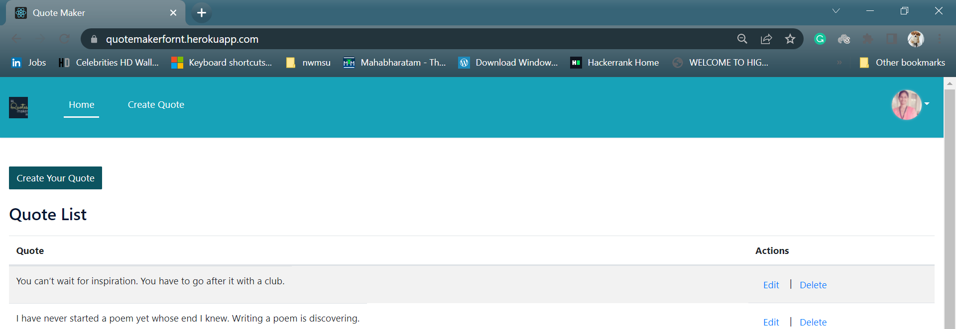
User Dashboard
https://quotemakerfornt.herokuapp.com/

Slide 8
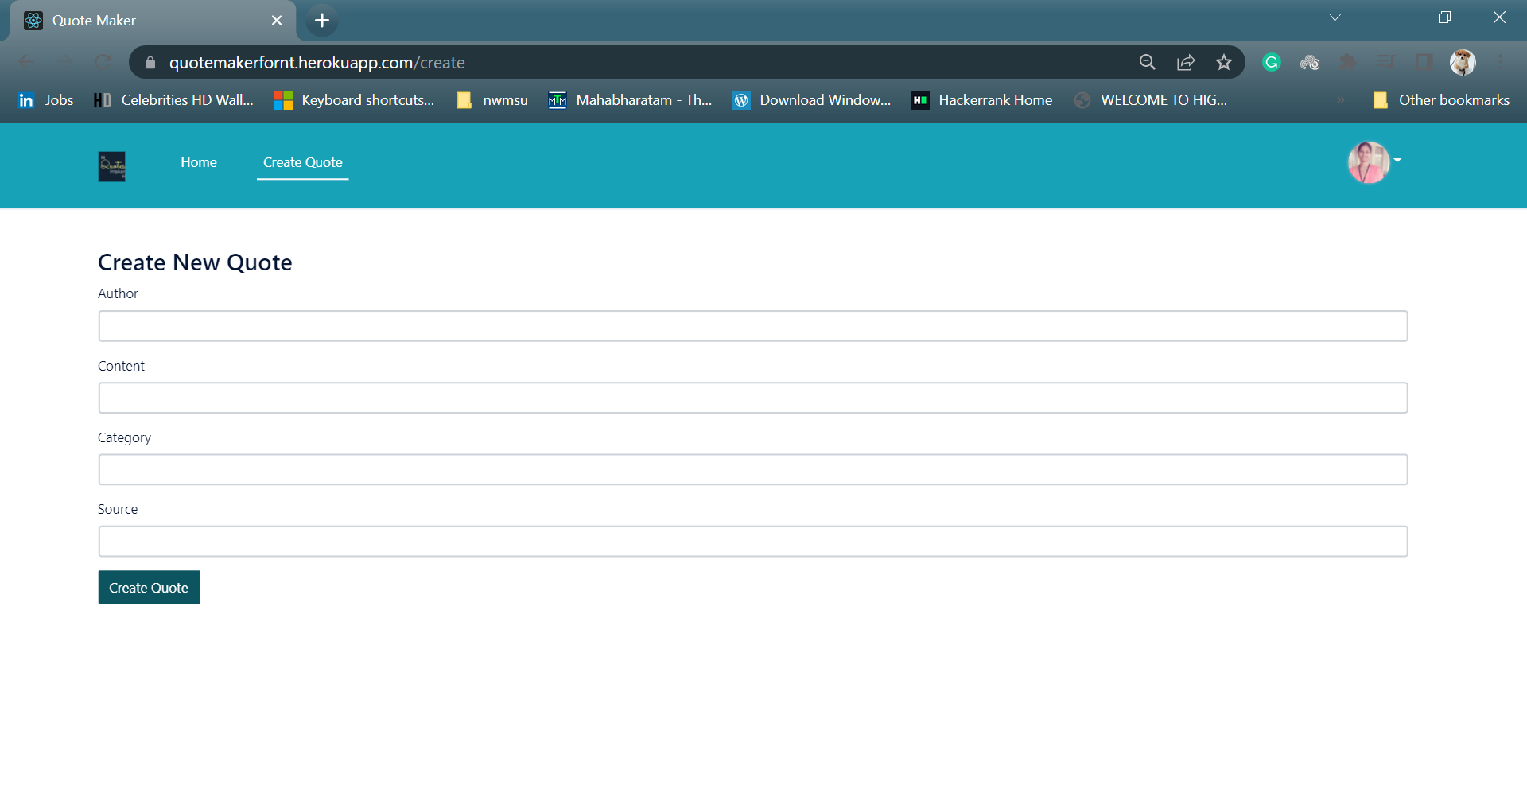
Create Page
https://quotemakerfornt.herokuapp.com/create

Slide 9
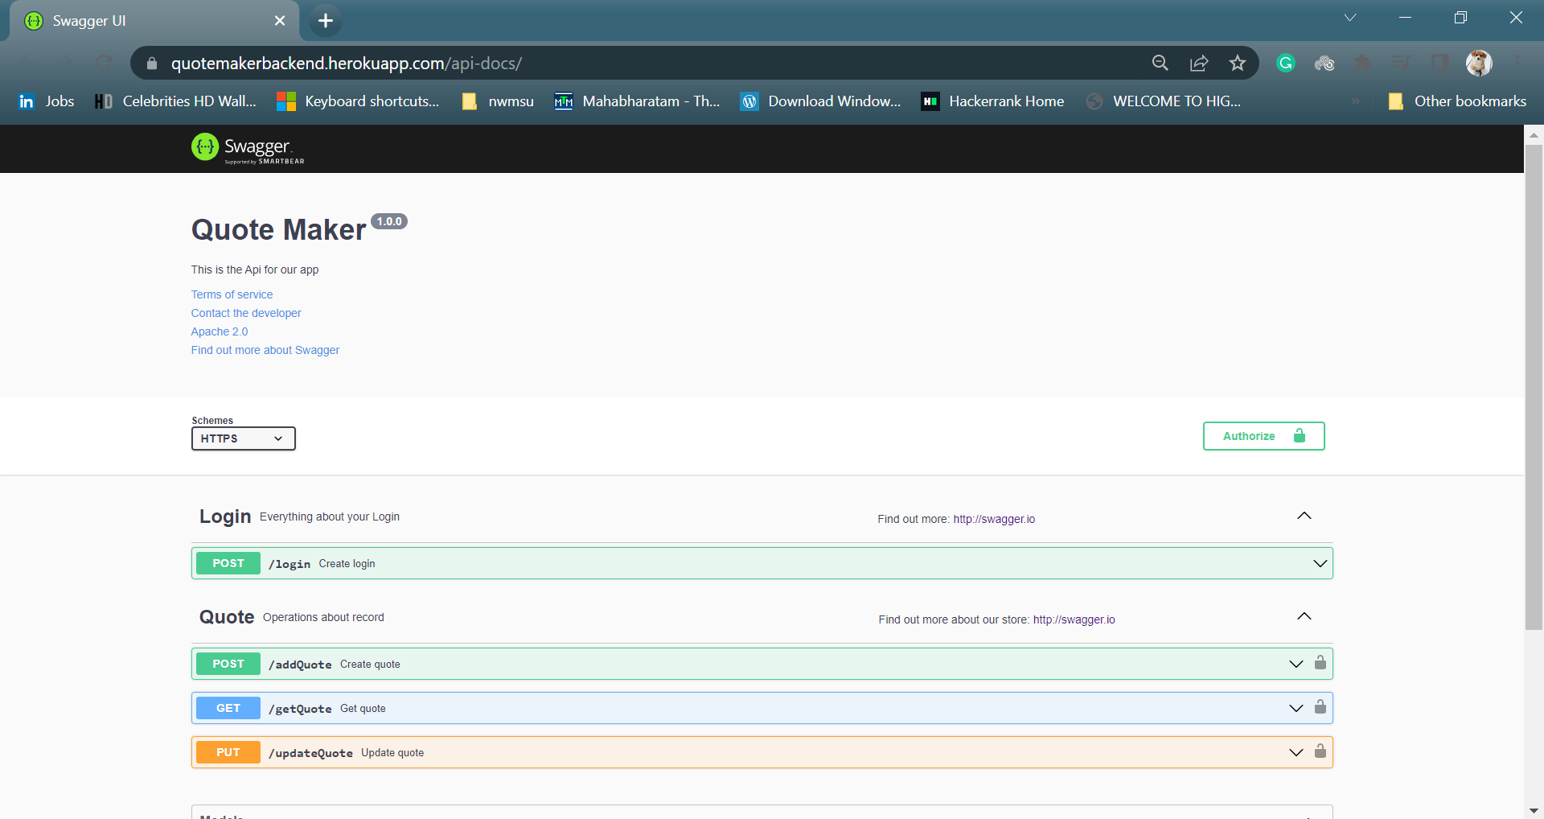
Swagger
https://quotemakerbackend.herokuapp.com/api-docs/

Slide 10
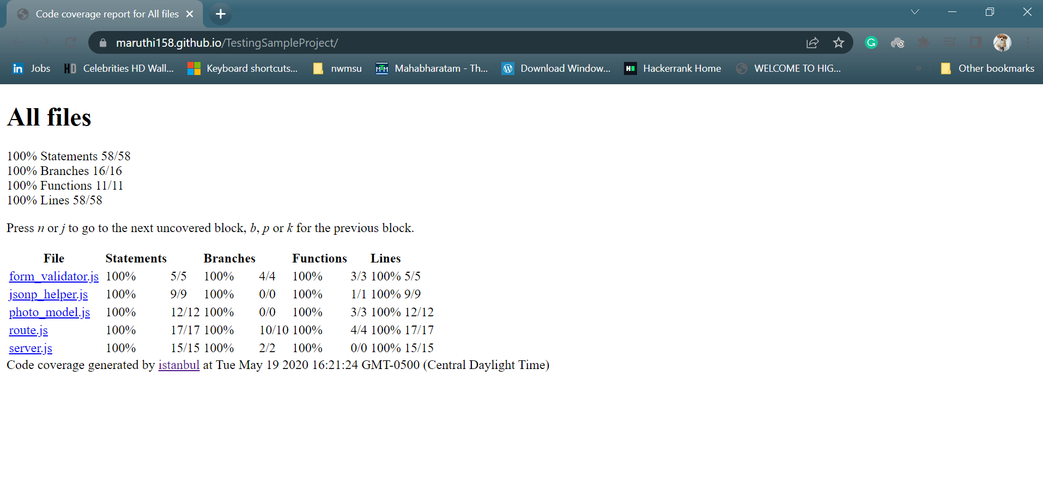
Code Coverage Report
https://maruthi158.github.io/TestingSampleProject/

Slide 11
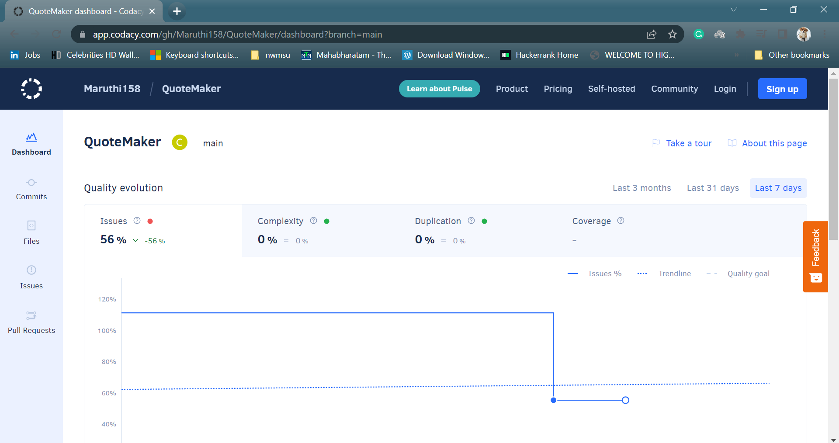
Codacy
https://app.codacy.com/gh/Maruthi158/QuoteMaker/dashboard?branch=main

Slide 12




Analysis Tools

Slide 13



Lessons Learned

Slide 14
References
https://github.com/piyush-eon/notezipper.git
https://youtu.be/govmXpDGLpo
https://github.com/testjavascript/nodejs-integration-tests-best-practices.git
https://youtu.be/EnMQm365t_s
https://youtu.be/--CsARIz2CM

Slide 15

Thank You!

